Slide 1

Roman law

Slide 2
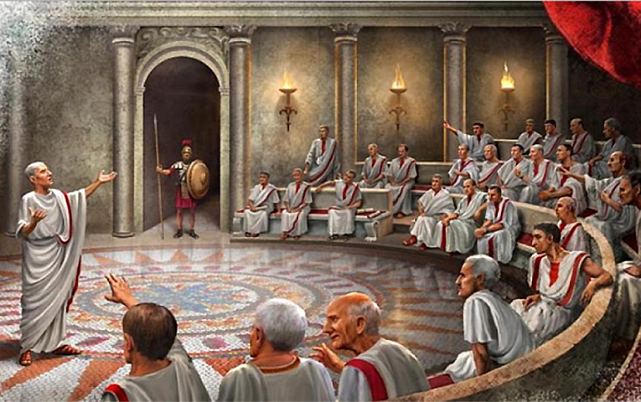
Roman law
Roman law, the law of ancient Rome from the time of the founding of the city in 753 BCE until the fall of the Western Empire in the 5th century CE. It remained in use in the Eastern, or Byzantine, Empire until 1453. As a legal system, Roman law has affected the development of law in most of Western civilization as well as in parts of the East. It forms the basis for the law codes of most countries of continental Europe and derivative systems elsewhere.

Slide 3
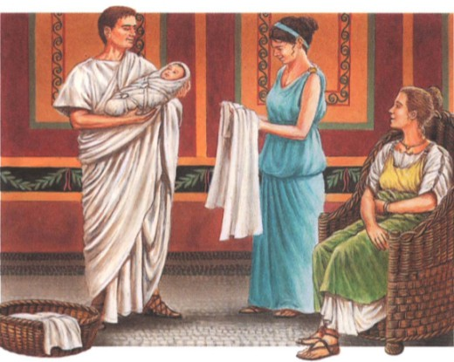
Family
The chief characteristic of the Roman family was the patria potestas (paternal power in the form of absolute authority), which the elder father exercised over his children and over his more remote descendants in the male line, whatever their age might be, as well as over those who were brought into the family by adoption—a common practice at Rome. Originally this meant not only that he had control over his children, but that he alone had any rights in private law. Thus, any acquisitions made by a child under potestas became the property of the father. The father might indeed allow a child (as he might a slave) certain property to treat as his own, but in the eye of the law it continued to belong to the father.

Slide 4

The law of property and possession
In Roman law (today as well as in Roman times), both land and movable property could be owned absolutely by individuals. This conception of absolute ownership (dominium) is characteristically Roman, as opposed to the relative idea of ownership as the better right to possession that underlies the Germanic systems and English law.
Mancipatio, or formal transfer of property, involved a ceremonial conveyance needing for its accomplishment the presence of the transferor and transferee, five witnesses (adult male Roman citizens), a pair of scales, a man to hold them, and an ingot of copper or bronze. The transferee grasped the object being transferred and said, “I assert that this thing is mine by Quiritarian [Roman] law; and let it have been bought by me with this piece of copper and these copper scales.” He then struck the scales with the ingot, which he handed to the transferor “by way of price.”

Slide 5
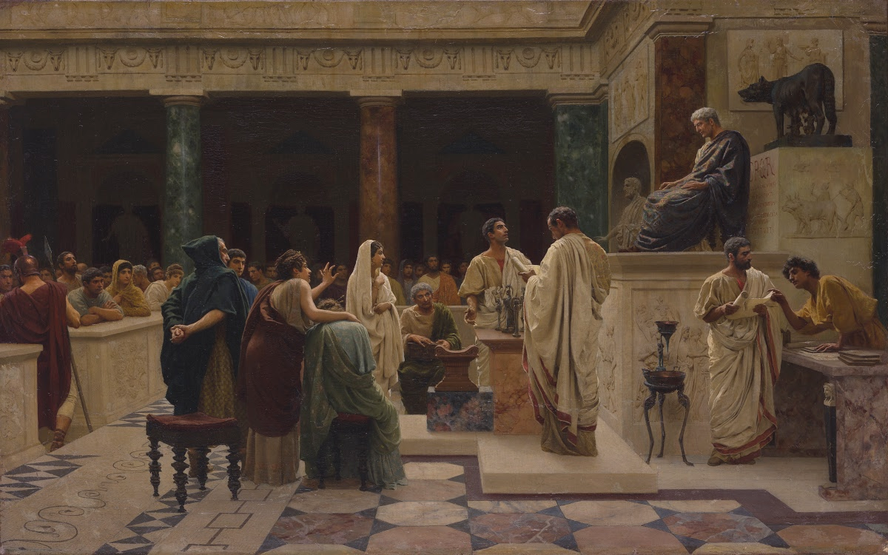
The law of procedure
The earliest law suits (legis actiones) were conducted orally in two stages: a preliminary one before the jurisdictional magistrate, in which the issue was developed; and then the actual presentation of evidence to the judex, or judge. The first stage required that set forms of words be spoken by the parties and, sometimes, by the magistrate. The parties making an assertion of ownership, for instance, would grasp the thing in dispute and lay a wand on it, after which the magistrate would intervene and say, “Let go, both of you.” So formal was the procedure that a plaintiff who made the slightest mistake lost his case. For the second stage, before the judex, there were no formal rules. However, the plaintiff had the burden of proof, was responsible for physically producing the defendant in court and, often, for carrying out the sentence.

Slide 6
Thanks for your attention!

